Slide 1




TechDocs
The ultimate platform for collaborative LaTeX writing
Team
IIITH SEDS APR 2022

Slide 2
Why TechDocs
Easy to use
Minimalistic UI
Cloud based tool
Live LaTex editor with in-built preview
Our Features
On-the-go LaTex-to-PDF file conversion
Auto save
Search completion
Plagiarism detector feature
Grammar and spelling-check
User Friendly
No need of software installation
Real time plagiarism and grammar check
Time Saver
Two level Security
(digital sign)
Paid features cost less
Compared to others
TechDocs Benefits
TechDocs

Slide 3
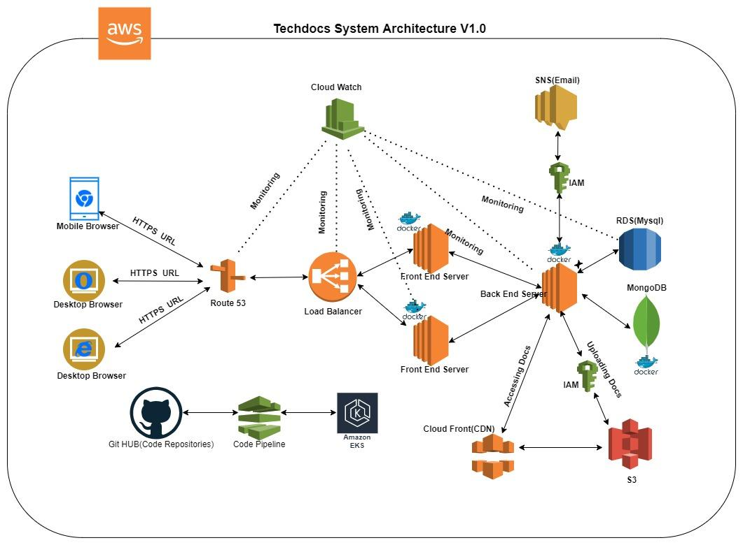
Techdocs Architecture
Upcoming Features
ML Stack
GingerIt
ScikitLearn
Legend
--- Unused features
— Upcoming features

Slide 4
Tech Stack
Techdocs
Front End
JavaScript - Actions and events
HTML - Static web pages and structure
Bootstrap - Style
JQuery - Querying the Database
Ajax - Sending/Receiving data to/from backend server
LatexJS/PrismJS - LaTex editor
Flask - Routing static pages
Docker and UWSGI - implementation
Backend
Python - General purpose programming language
MySQL - Database
Flask - API endpoint handling
SQLAlchemy - SQL Operations
Mailjet - SMTP server
Docker - implementation
Upcoming Features:
GingerIt (ML)
ScikitLearn (ML
Deployment
AWS Cloud Suite
EC2 - Frontend and Backend servers
Load balancer - HTTP/HTTPS listeners
RDS - Database provider (at extra cost)
CloudWatch – Monitoring (at extra cost)
Certificate Manager - OpenSSL (at extra cost)
IAM - User access rules
GUNICORN - Running frontend and backend service
Github - Code versioning and repository
Explorations:
SNS, SES
S3
Code Pipeline
Kubernetes

Slide 5
WORK FLOW- PROCESS
Either register or login using gmail
Decide on business case
Click on new project
DOCUMENT Ready
USER
Registration 2
Login
Open New project
Edit the document
Sharing the Document
Exporting the document as PDF
Username & Password
Build a document
Development of product

Slide 6
Professors/Researchers
Students
Free version available for students with less features
Can work on journals/patents and can convert easily to PDF
Can access services and complete assignments
No need to be tech savvy
Features
Grammar and plagiarism check
Resume/ CV can be easily prepared
Ŧ Documents are secured (Digital signature)
Auto Save ensures document protection
Ŧ Can send the documents/assignments easily to required dept
Value for time and money
Ŧ: Future Scope

Slide 7

Future Scope
Digital Signature
Assures 2 level protection for document safety
Advanced Plagiarism check
For advanced levels of plagiarism
Login with orcid,
Login with research oriented ids like Orcid,Publons,etc
Multilingual Support
Supporting languages other than English

Slide 8
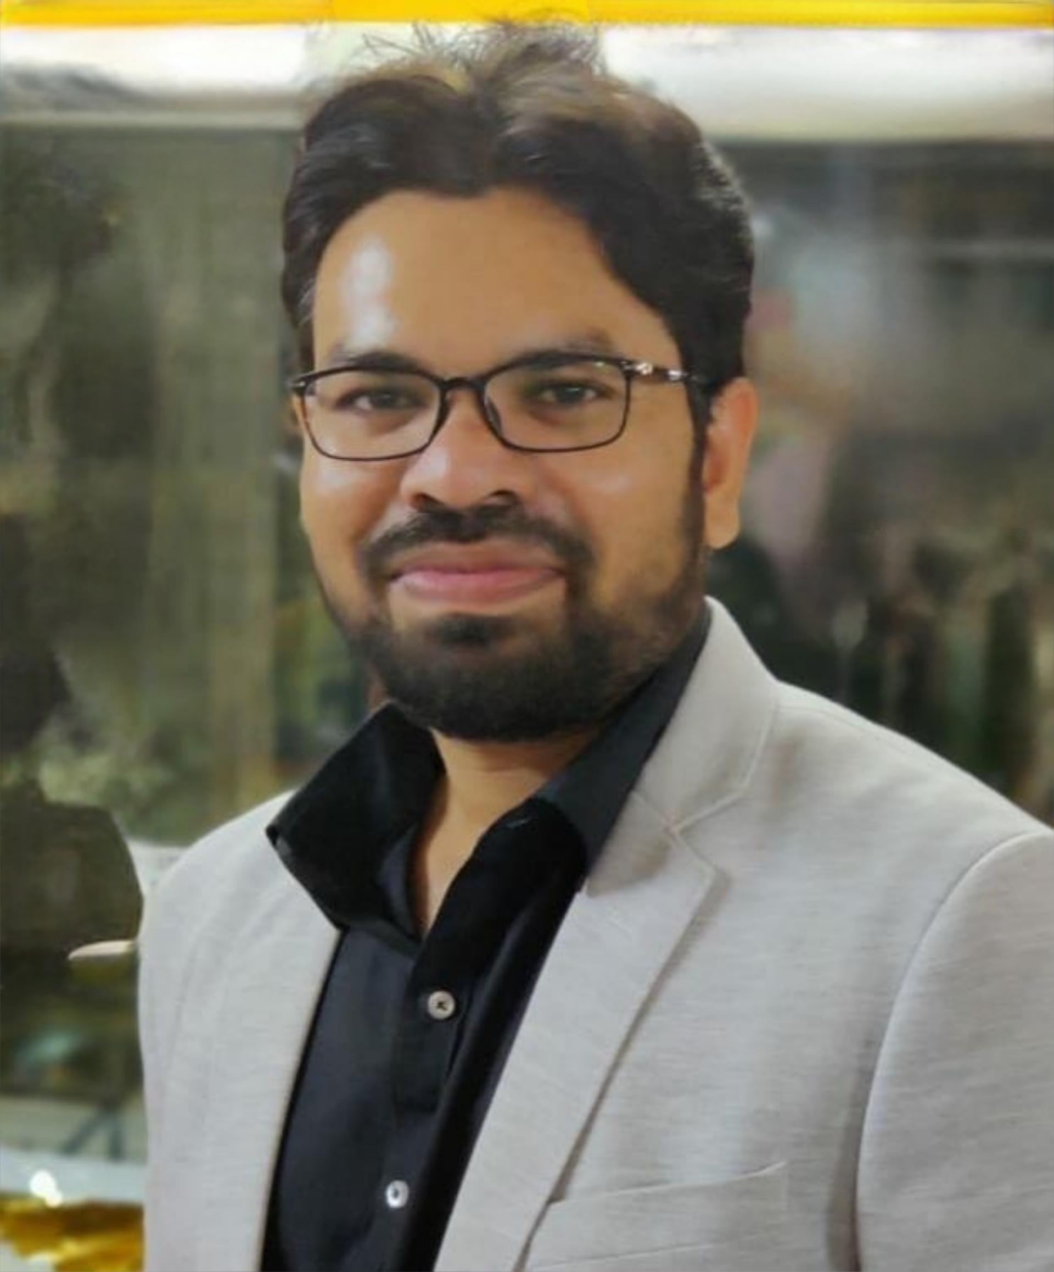

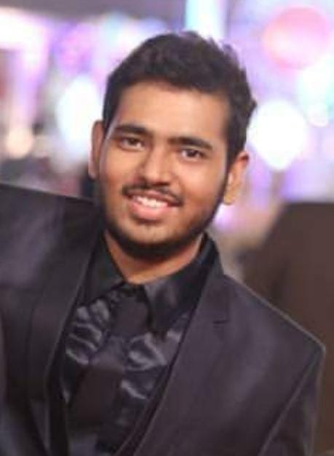
Yogesh Barai
Project Manager
Team Members and tasks handled
PL Yogesh Barai Front End Jacob Srilatha Sasi Pritham Sasidhar Isha Jain Nitish Reddy
2. Backend and Database Bhavana Gadadhar Prashant Suravaram Radhika
3. Deployment Arun (Deployment Lead) Fatma Munasib Shritik Saxena Ruchir Integration Preetam Sahil rai
4. Documentation Sreelakshmi (Lead) Shital Manisha
5. Testing Medha Gayatri 6. Analytics Avadesh
Bhavana N
Backend
Gadadhar T
Backend
Prasanth
Backend
S Radhika
Backend
Sasi Pritham
Frontend
Jacob
Frontend
Isha Jain
Front end
A Nitish Reddy
Front end
Srilatha
Front end
Sashidhar
Frontend
Sreelakshmi
Documentation
Shital
Documentation
Manisha
Documentation
Avadesh Pratap
Analytics
Arun K
Deployment
Mohammad Munasib
Deployment
Shritik Saxena
Deployment
Ruchir S Pohekar
Deployment
Fatma R
Deployment
Preetam
Integration
Sahil Rai
Integration
Medha Gayathri
Testing

Slide 9
Links
Github Repo
project link Deployment Video

Slide 10
Thank You
Q & A

